Slide 1
Models for Understanding and Controlling Global Infectious Diseases HUMBIO 154D / HRP 204
Session 9
Jason Andrews
Jeremy Goldhaber-Fiebert
2020

Slide 2
Course Roadmap
First Models
SIR models with demography
Reproductive Number, Thresholds, Equilibria
Lab: Dynamic Models in R
Heterogeneous mixing and temporal modeling
Emerging infections: takeoff, growth, extinction
Lab: Emerging infections
Vectors, zoonoses, & environmental transmission
Stochastic dynamics
Spatial models, networks
Interventions and sensitivity analyses
Lab: Interventions and sensitivity analyses
Competition and evolutionary models
Within host evolution
Lab on Parameterization, calibration, and uncertainty
Health policy and economic evaluation models
Uses and abuses of models

Slide 3
“THE REAL WORLD CONTAINS RANDOMNESS”

Slide 4
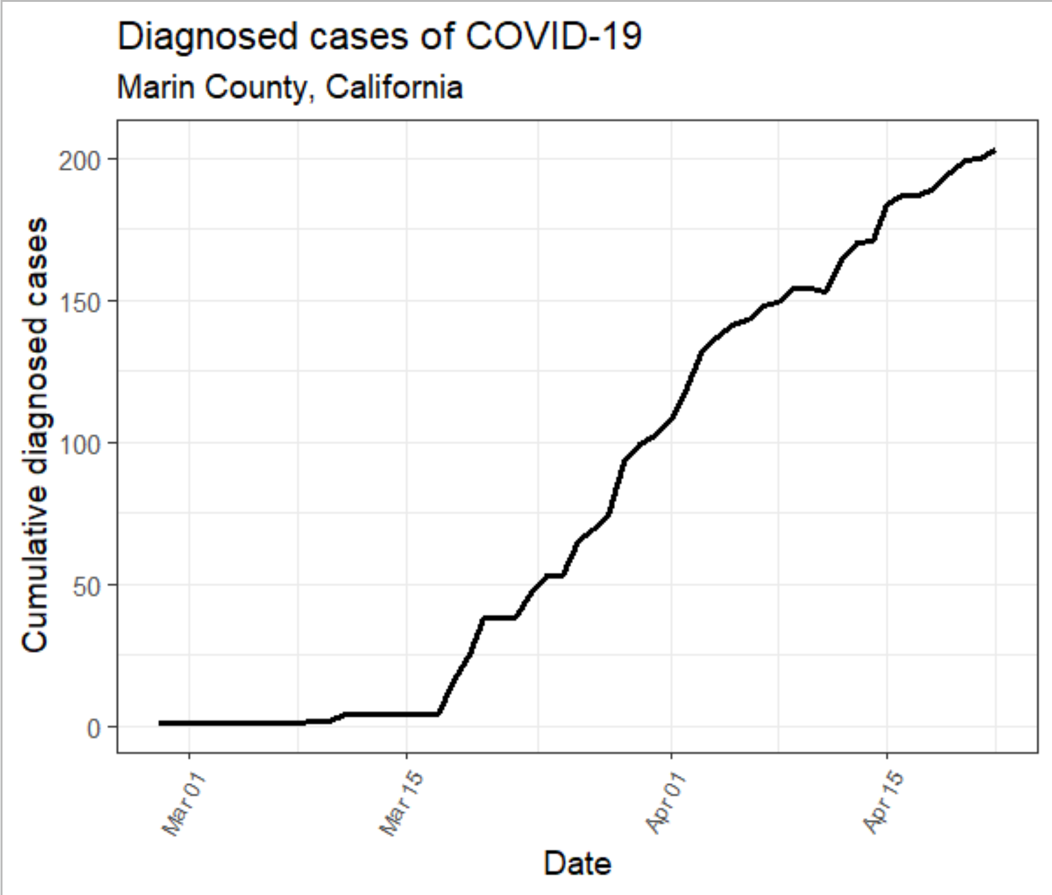
259,000 total population
~0.07% prevalence (diagnosed)

Slide 5
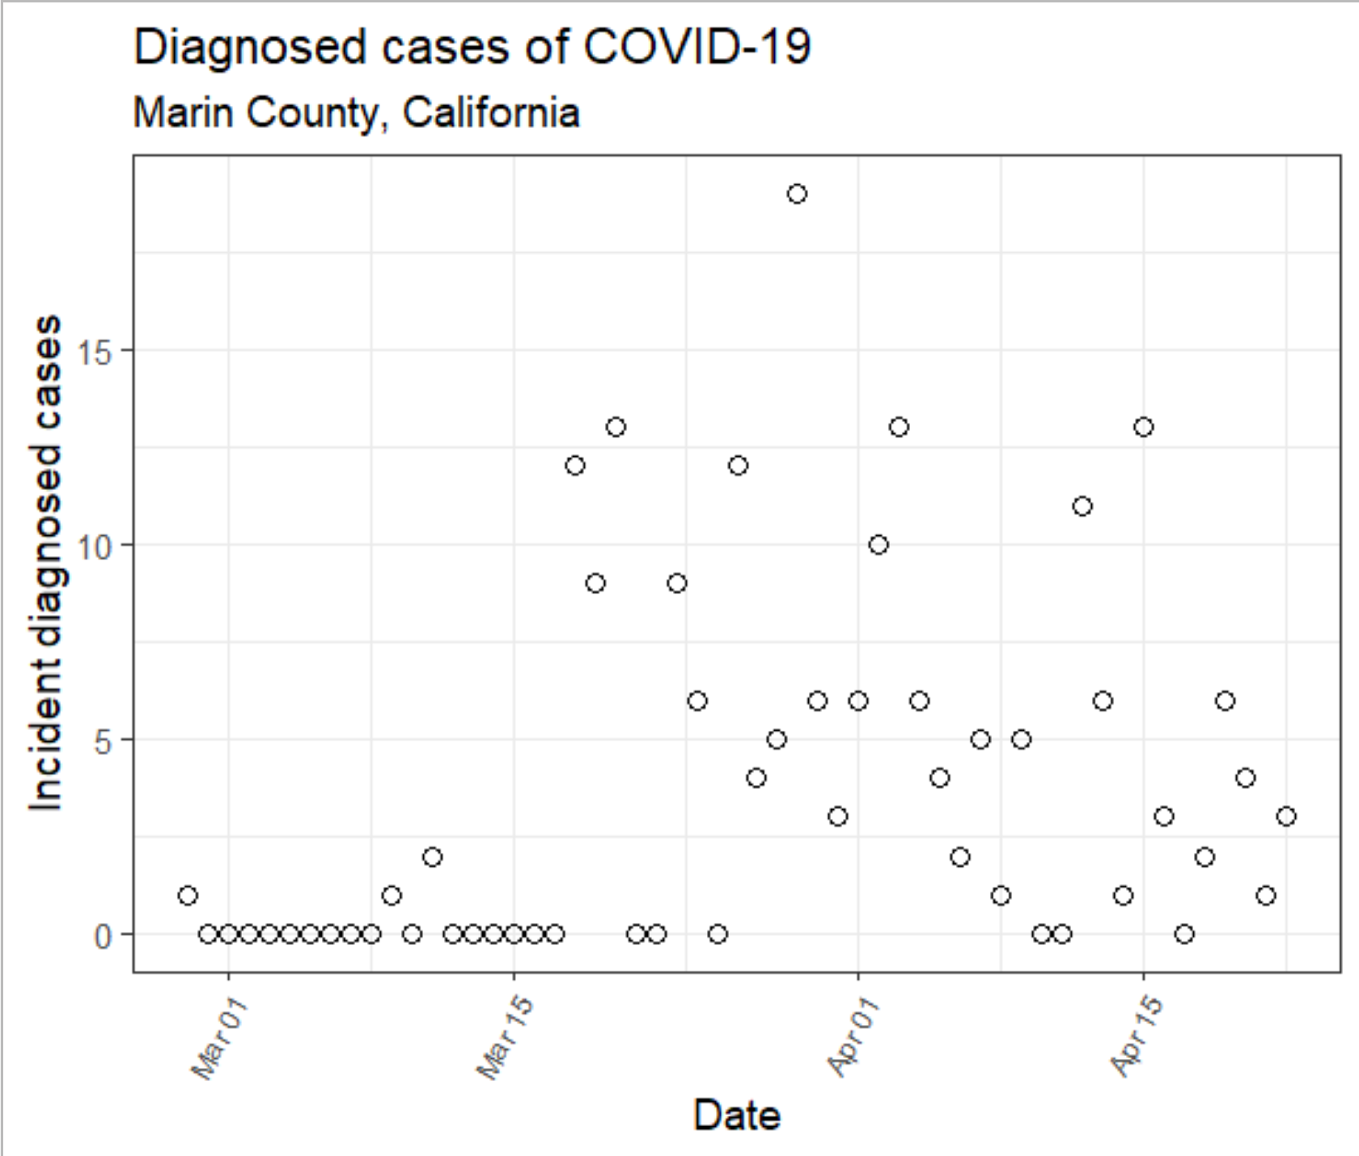
What do you notice about
this incidence data?

Slide 6
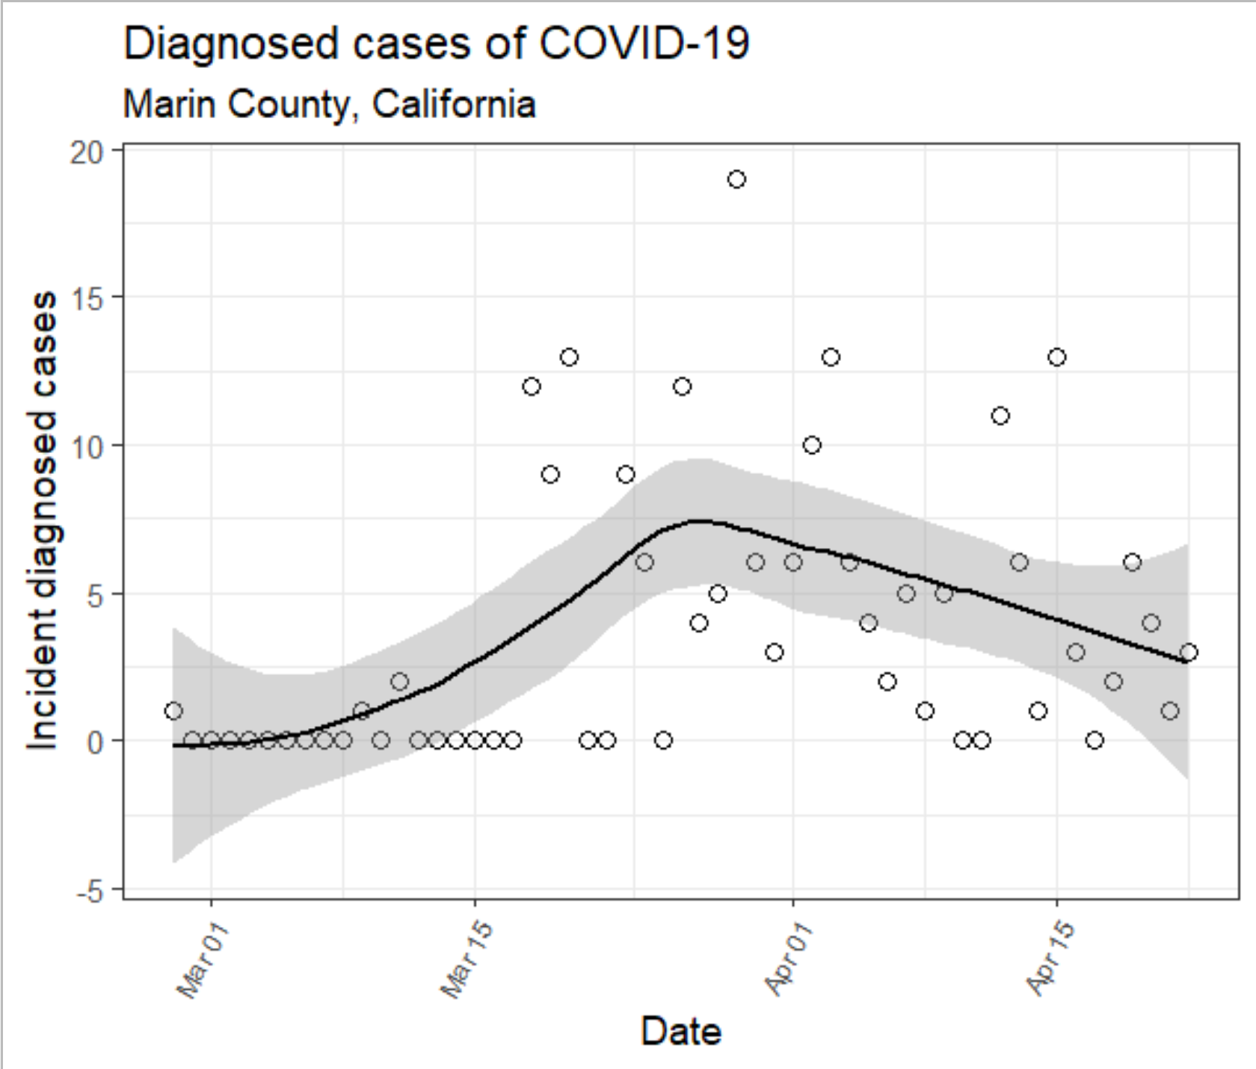

Slide 7
Practical Questions
How and when does stochasticity/randomness make the predictions/insights from the models we have been examining to date less applicable?
What patterns should we expect to see in real-world dynamics of infectious diseases because of stochasticity/randomness?

Slide 8
Learning Objectives
Define continuous versus discrete and explain how they characterize model differences
Define deterministic versus stochastic and explain how they characterize model differences
Understand how stochastic continuous time models differ from deterministic continuous time models
Understand how stochastic discrete time models differ
Describe stochastic extinction/fade-out and the conditions under which it is more likely
Describe the critical community size threshold
Describe importation and how it relates to the likelihood of extinction/critical community size

Slide 9
Continuous vs. Discrete
Apply to
Quantities being modeled
Time steps in the model

Slide 10
Continuous vs. Discrete
Apply to
Quantities being modeled: Continuous
Time steps in the model
S_{C}
I_{C}
R_{C}
βI
γ
S_{A}
βI
I_{A}
γ
R_{A}

Slide 11
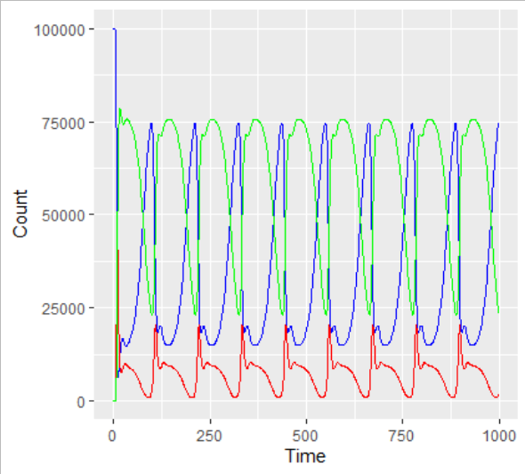
Continuous vs. Discrete
Apply to
Quantities being modeled: Continuous
Time steps in the model
S_{C}
I_{C}
R_{C}
βI
γ
S_{A}
βI
I_{A}
γ
R_{A}

Slide 12
Continuous vs. Discrete
Apply to
Quantities being modeled: Continuous
Time steps in the model
X_{C}
Y_{C}
Z_{C}
βI
γ
X_{A}
βI
Y_{A}
γ
Z_{A}

Slide 13
Continuous vs. Discrete
Apply to
Quantities being modeled: Discrete
Time steps in the model
X_{C}
Y_{C}
Z_{C}
βI
γ
X_{A}
βI
Y_{A}
γ
Z_{A}

Slide 14
Continuous vs. Discrete
Apply to
Quantities being modeled: Discrete
Time steps in the model
Quantity
21
20.43
20
Time

Slide 15
Continuous vs. Discrete
Apply to
Quantities being modeled: Discrete
Time steps in the model
Quantity
21
20.43
20
Time

Slide 16
Continuous vs. Discrete
Apply to
Quantities being modeled: Discrete
Time steps in the model: Continuous vs. Discrete
Quantity
21
20.43
20
5
6
6.2
7
Time

Slide 17
Continuous vs. Discrete
Apply to
Quantities being modeled: Discrete
Time steps in the model: Continuous vs. Discrete
Quantity
21
20.43
20
5
6
6.2
7
Time

Slide 18
Deterministic vs. Stochastic
Deterministic: Each time I run one of our differential equation models (SI, SIS, SIR, SEIR, etc), with the same parameter inputs (gamma, beta, etc.), I get the same values out
Values out can have complex patterns, but they are the same each time

Slide 19
Deterministic vs. Stochastic
Our ODEs are functions of input parameters and time {S(t), I(t), R(t)} = f_ODE(params, t)
For stochastic, let’s think about simpler functions that just depend on parameters (actually 1 parameter) (we sample them onces per simulation and not once per time point per simulation)
So let’s let f(parameter) = parameter*t²

Slide 20
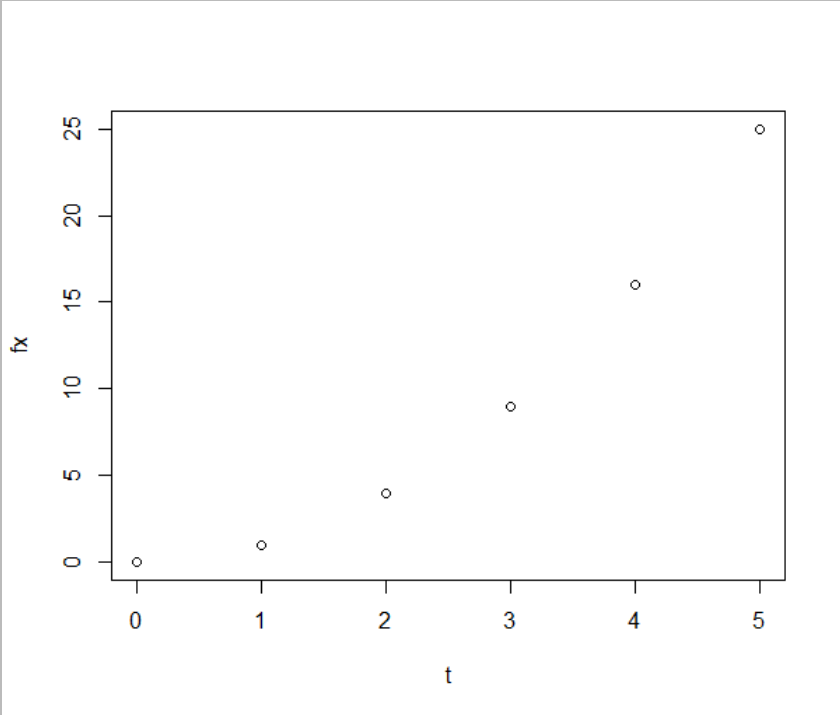
Deterministic vs. Stochastic
The deterministic version of f(parameter) = parameter*t² is: (where parameter = x = 1)

Slide 21
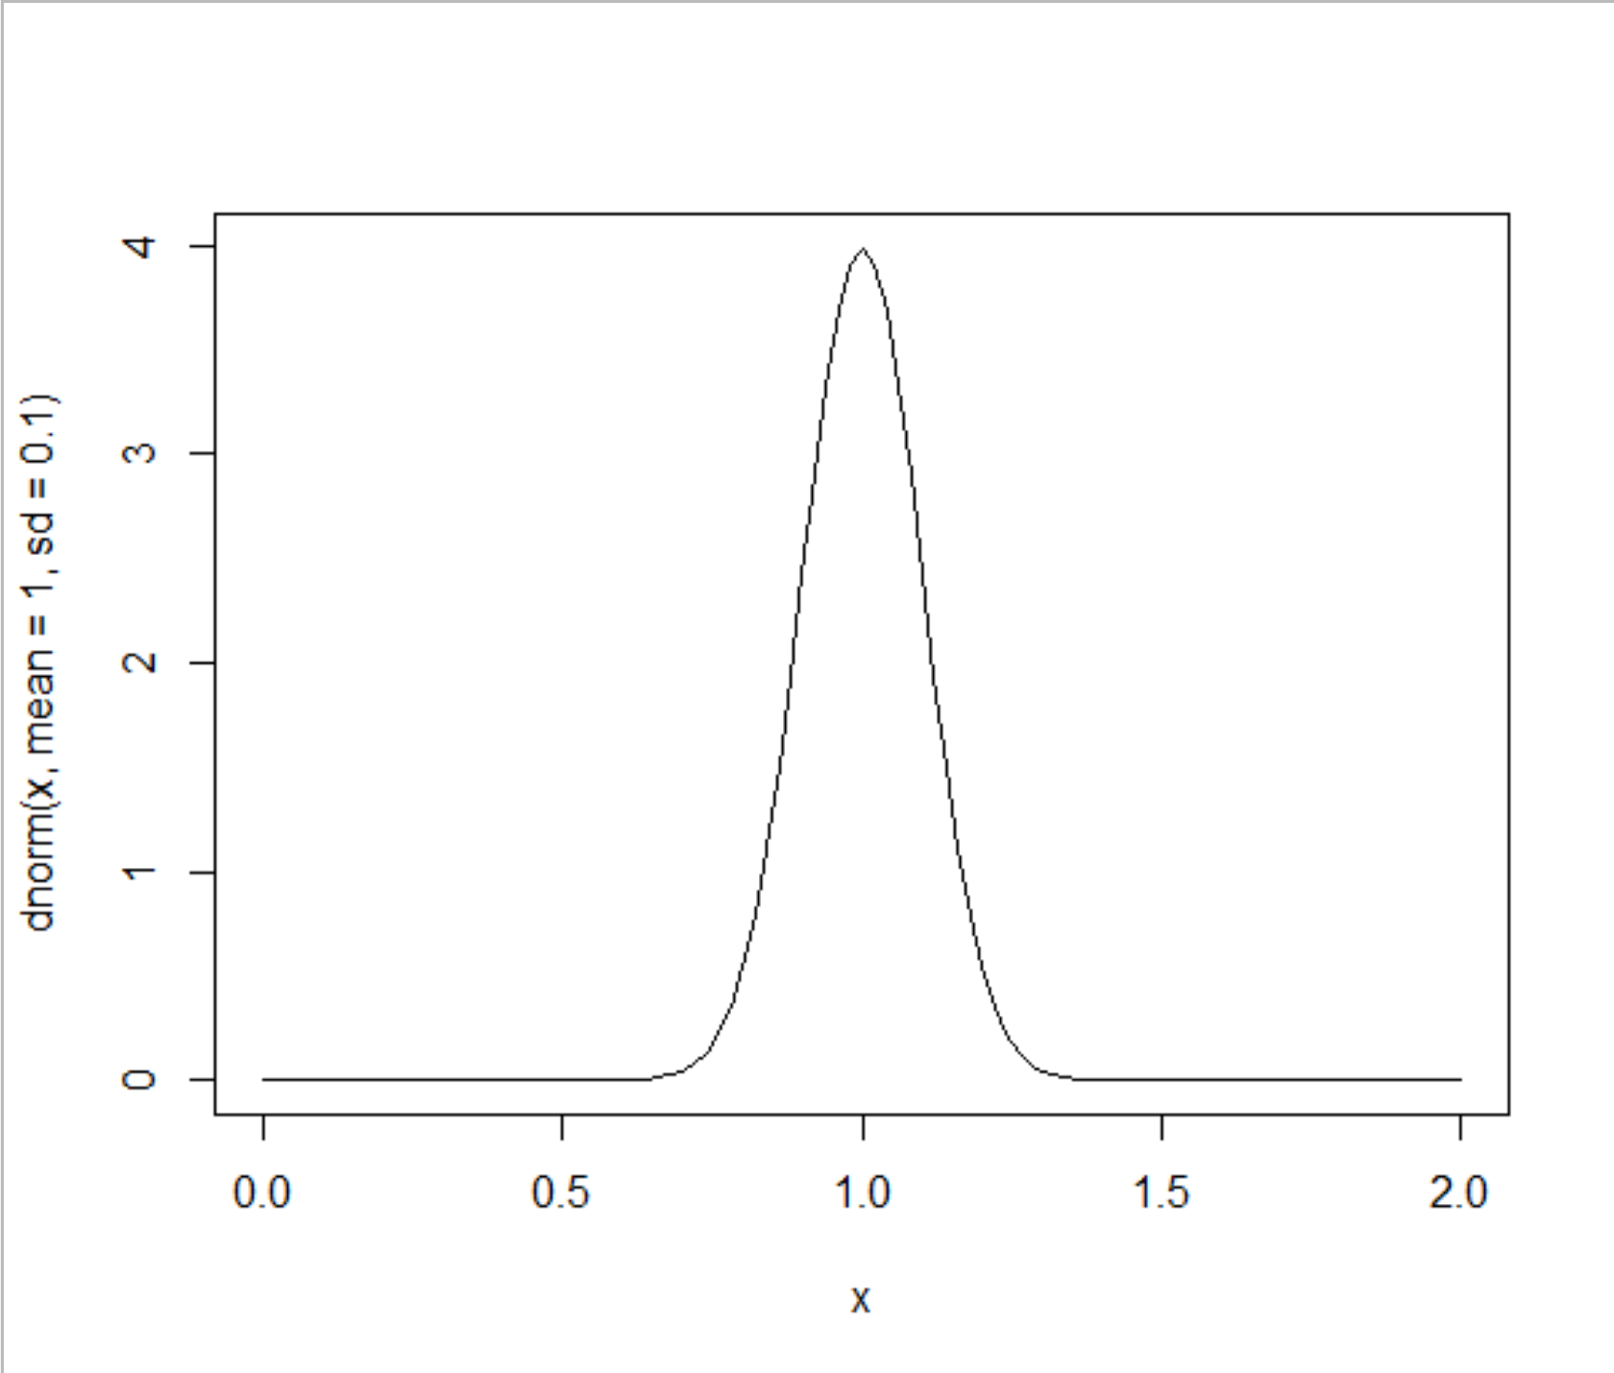
Deterministic vs. Stochastic
The stochastic version of f(parameter) = parameter*t² : let’s let x ~ 1+Normal(0,0.1)

Slide 22
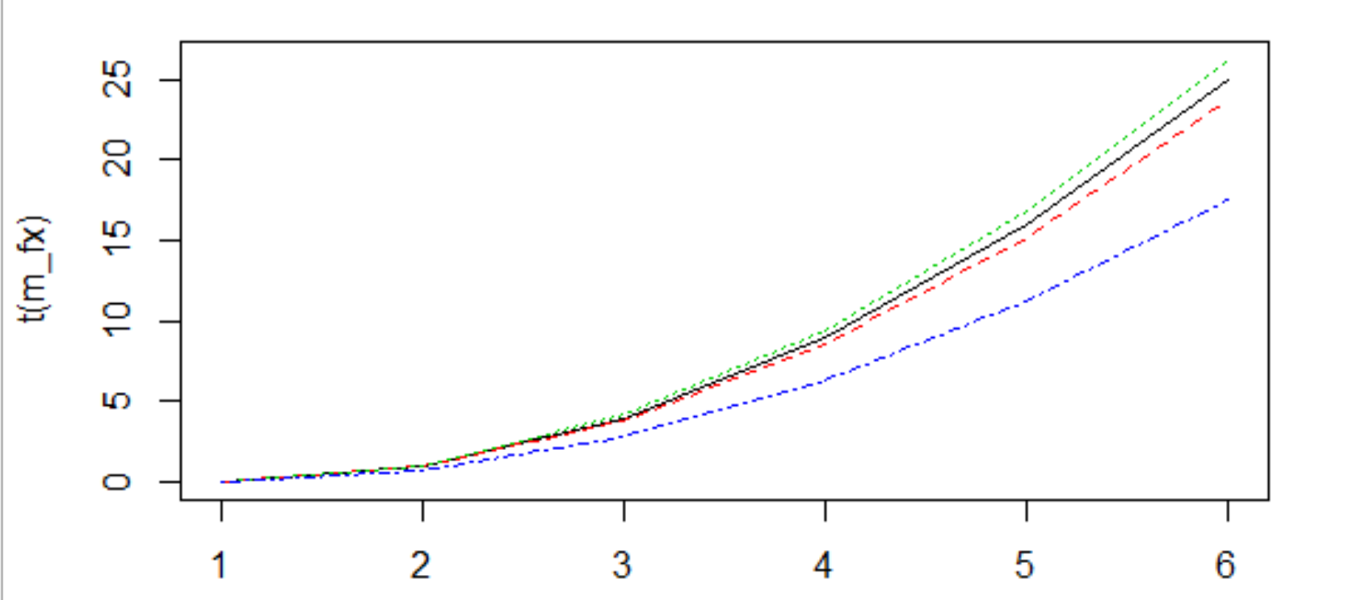
Deterministic vs. Stochastic
The stochastic version of f(parameter) = parameter*t² : so when sample of x is < 1 then line rises more slowly (blue) or more rapidly (green)

Slide 23
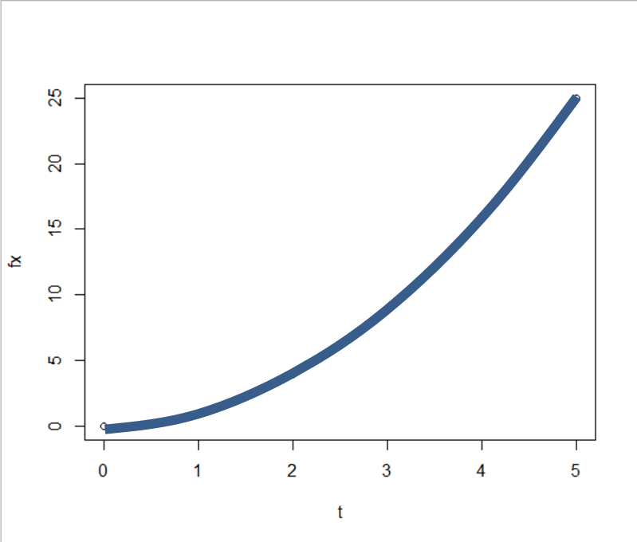
Deterministic vs. Stochastic
This means that our model (with same parameter(s)) does not produce the same output each time it is run: it is stochastic
Deterministic
Stochastic

Slide 24
Nerd Aside: Random Numbers
Chapter talks about a Random Number Generator (RNG)
What it actually means is a Pseudo-Random Number Generator
Why?
Because computers cannot really do random things themselves
What they can do is things whose patterns are very hard to predict
Given that I have seen a lot of samples from a stream of “random numbers” sampled from an RNG, it will be nearly impossible to predict the next

Slide 25
What real-world randomness should be reflected in the model?
X_{C}
Y_{C}
Z_{C}
βI
γ
X_{A}
βI
Y_{A}
γ
Z_{A}
Everyone has an average 4 contacts per week but this month it happened to be lower (like seasonal forcing but not a predictable sine wave)
The virus is more transmissible in cold damp conditions, but some weeks will be warmer and dryer
Some people who get infected took a lot longer (or a lot less time) to recover than 1/gamma (average duration of infectiousness)

Slide 26
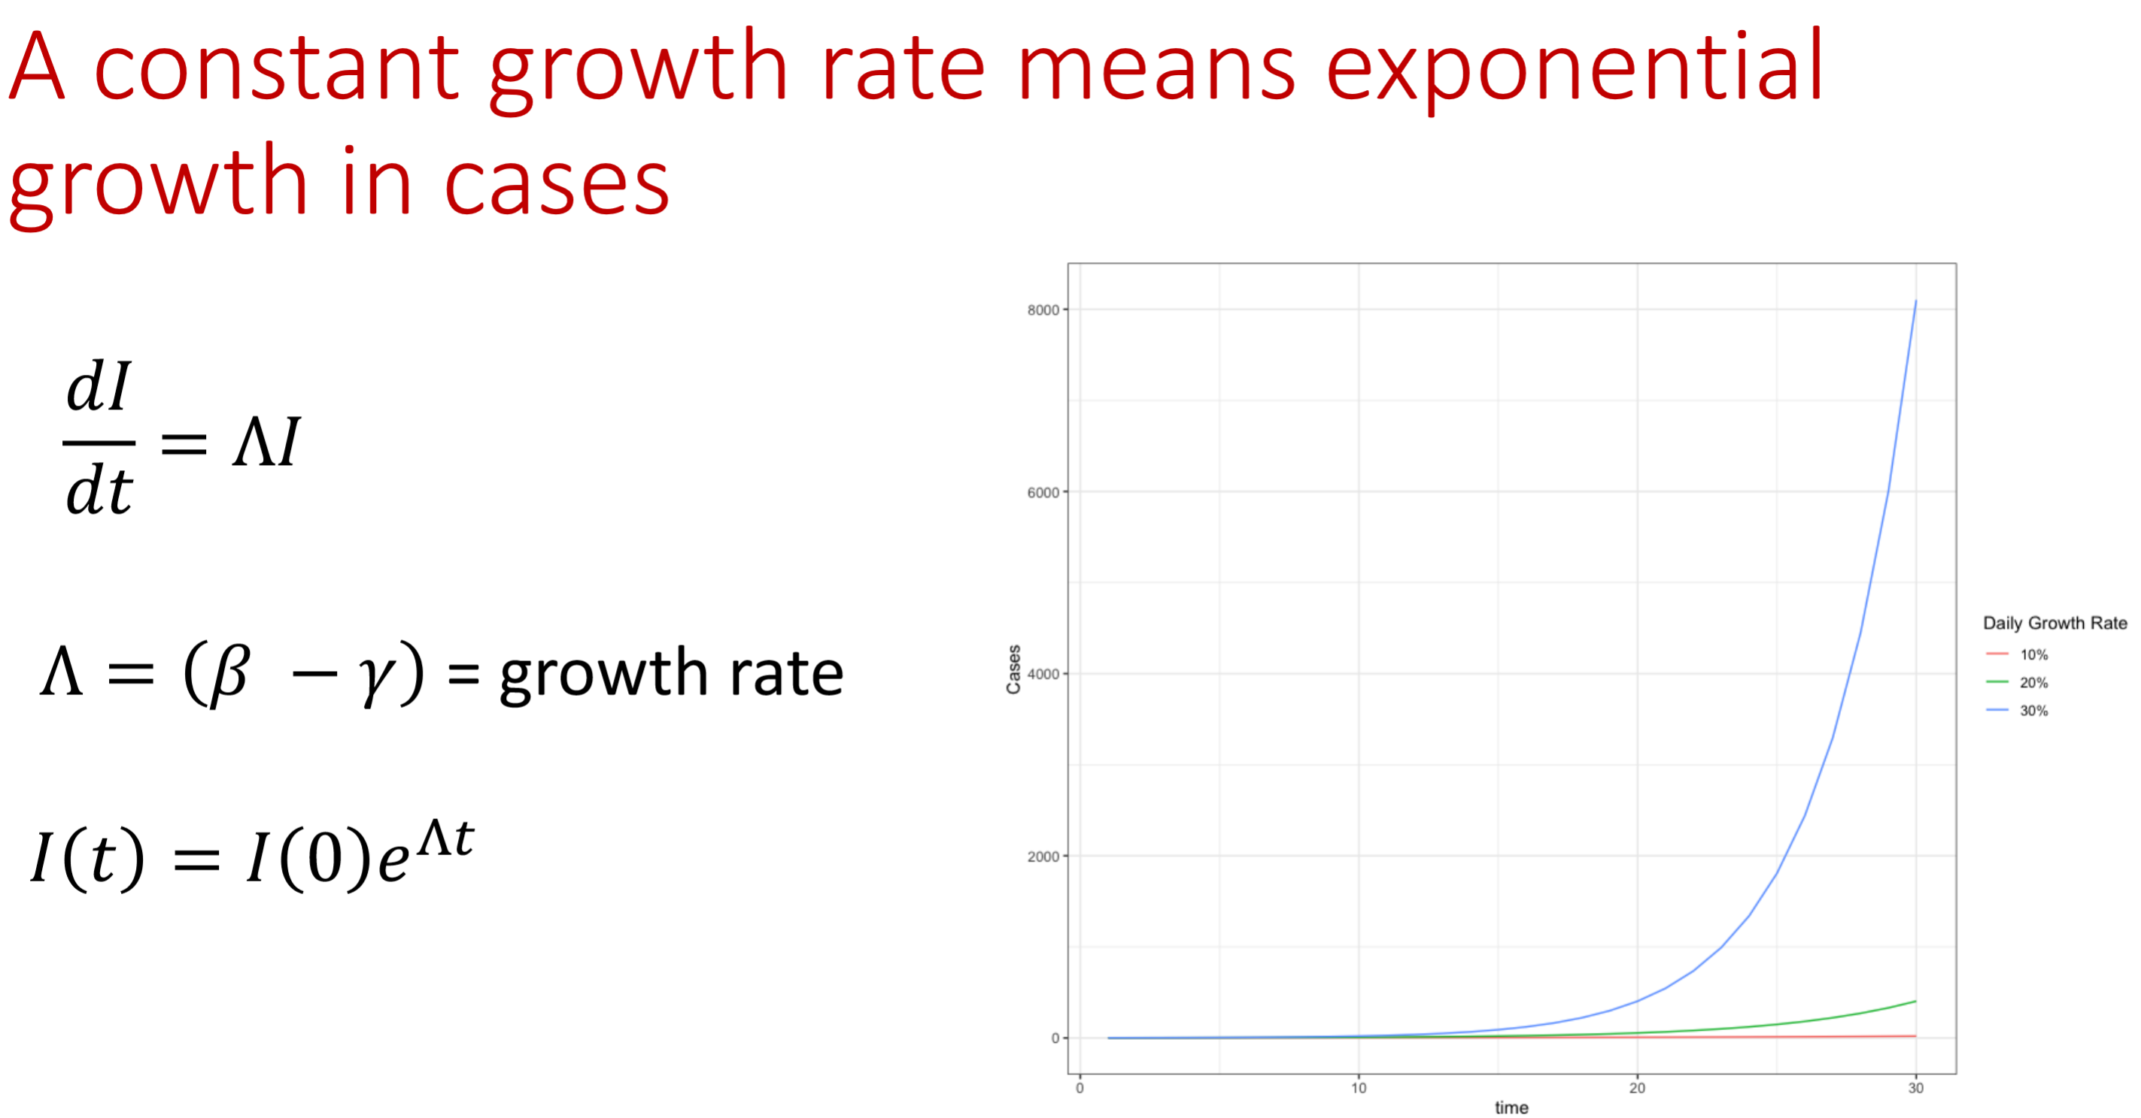
We will first illustrate random ODE model parameters with a simpler model: recall…
If we imagine that either beta or gamma fluctuate randomly over time, then lambda will fluctuate randomly over time too. What will that do to the exponential growth of our emerging epidemic?

Slide 27
Code for the deterministic exponential growth model
r_transmission <- 0.03
c_contacts <- 5
c_beta <- r_transmission * c_contacts
c_gamma <- 1/10
c_lambda <- (c_beta - c_gamma)
c_end_time <- 100
v_times <- seq(0, c_end_time)
v_lambdas <- rep(c_lambda, length(v_times))
c_I0 <- 1
do_emergence <- function(I0, lambdas, times) {
It <- I0 * exp(lambdas * times)
return(It)
}
v_It <- do_emergence(c_I0, v_lambdas, v_times)

Slide 28
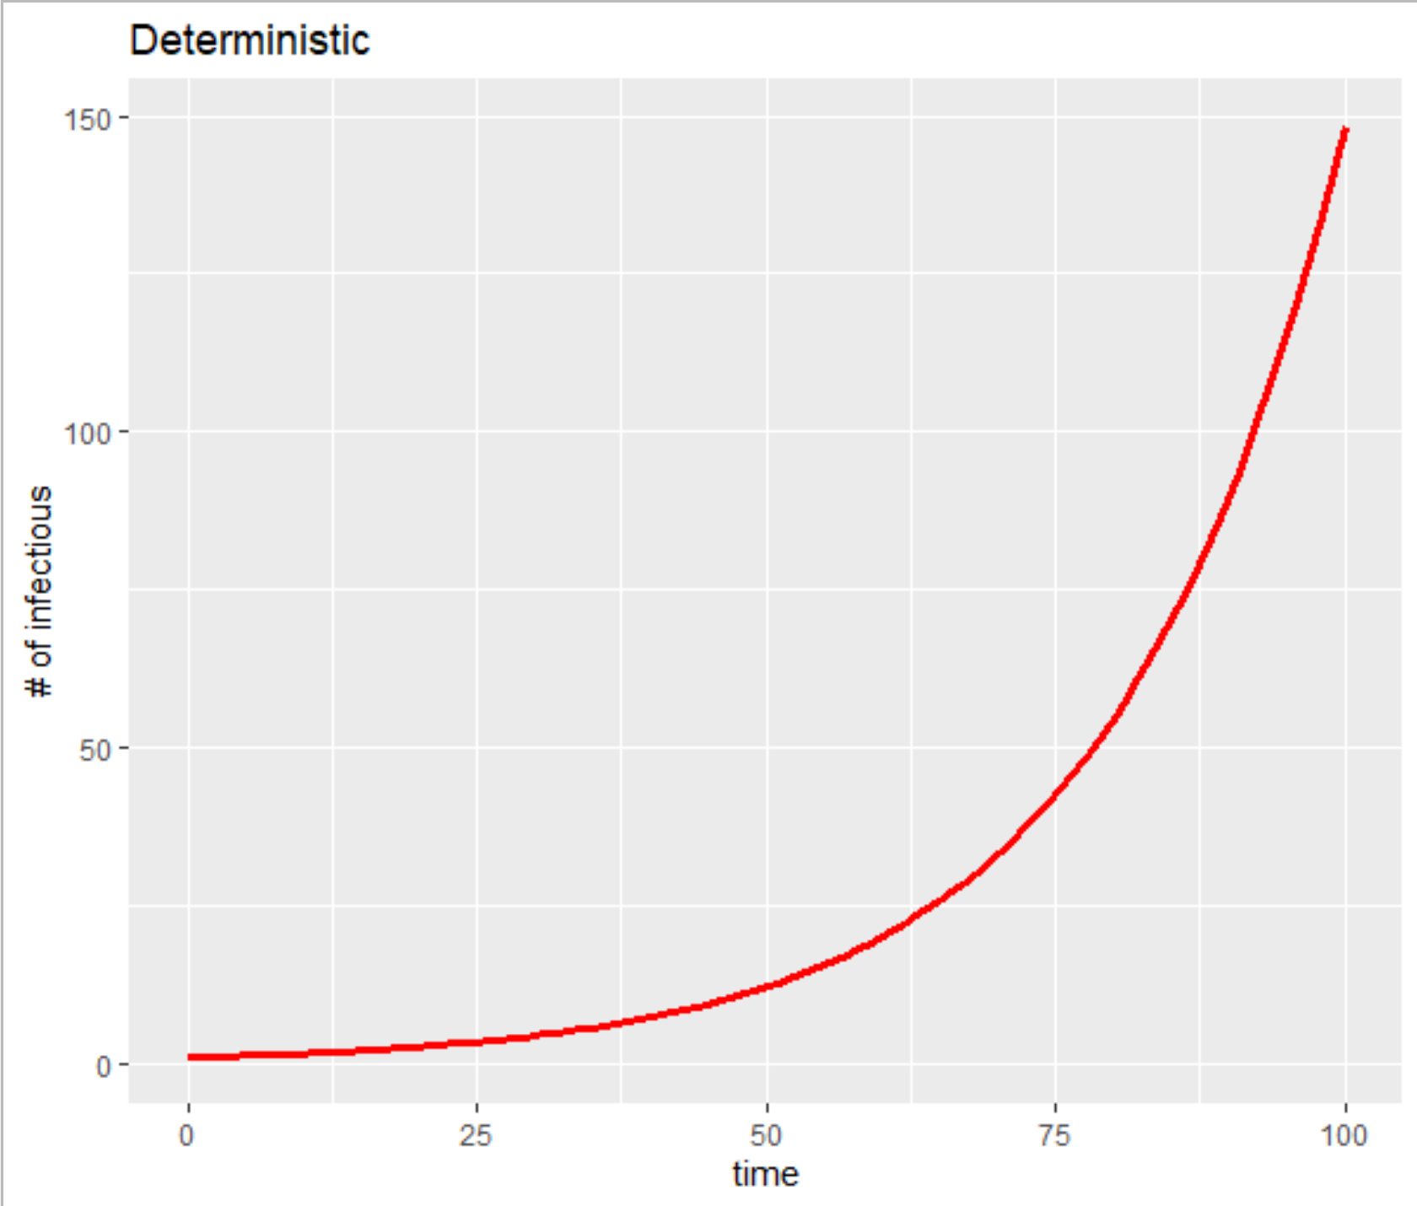

Slide 29
Code for the deterministic exponential growth model
v_lambdas_noise <- v_lambdas + rnorm(length(v_lambdas))/200
v_It_noise <- do_emergence(c_I0, v_lambdas_noise,
v_times)
v_lambdas_noise_l <- v_lambdas + rnorm(length(v_lambdas))/400
v_It_noise_l <- do_emergence(c_I0, v_lambdas_noise_l,
v_times)
v_lambdas_noise_m <- v_lambdas + rnorm(length(v_lambdas))/100
v_It_noise_m <- do_emergence(c_I0, v_lambdas_noise_m,
v_times)

Slide 30
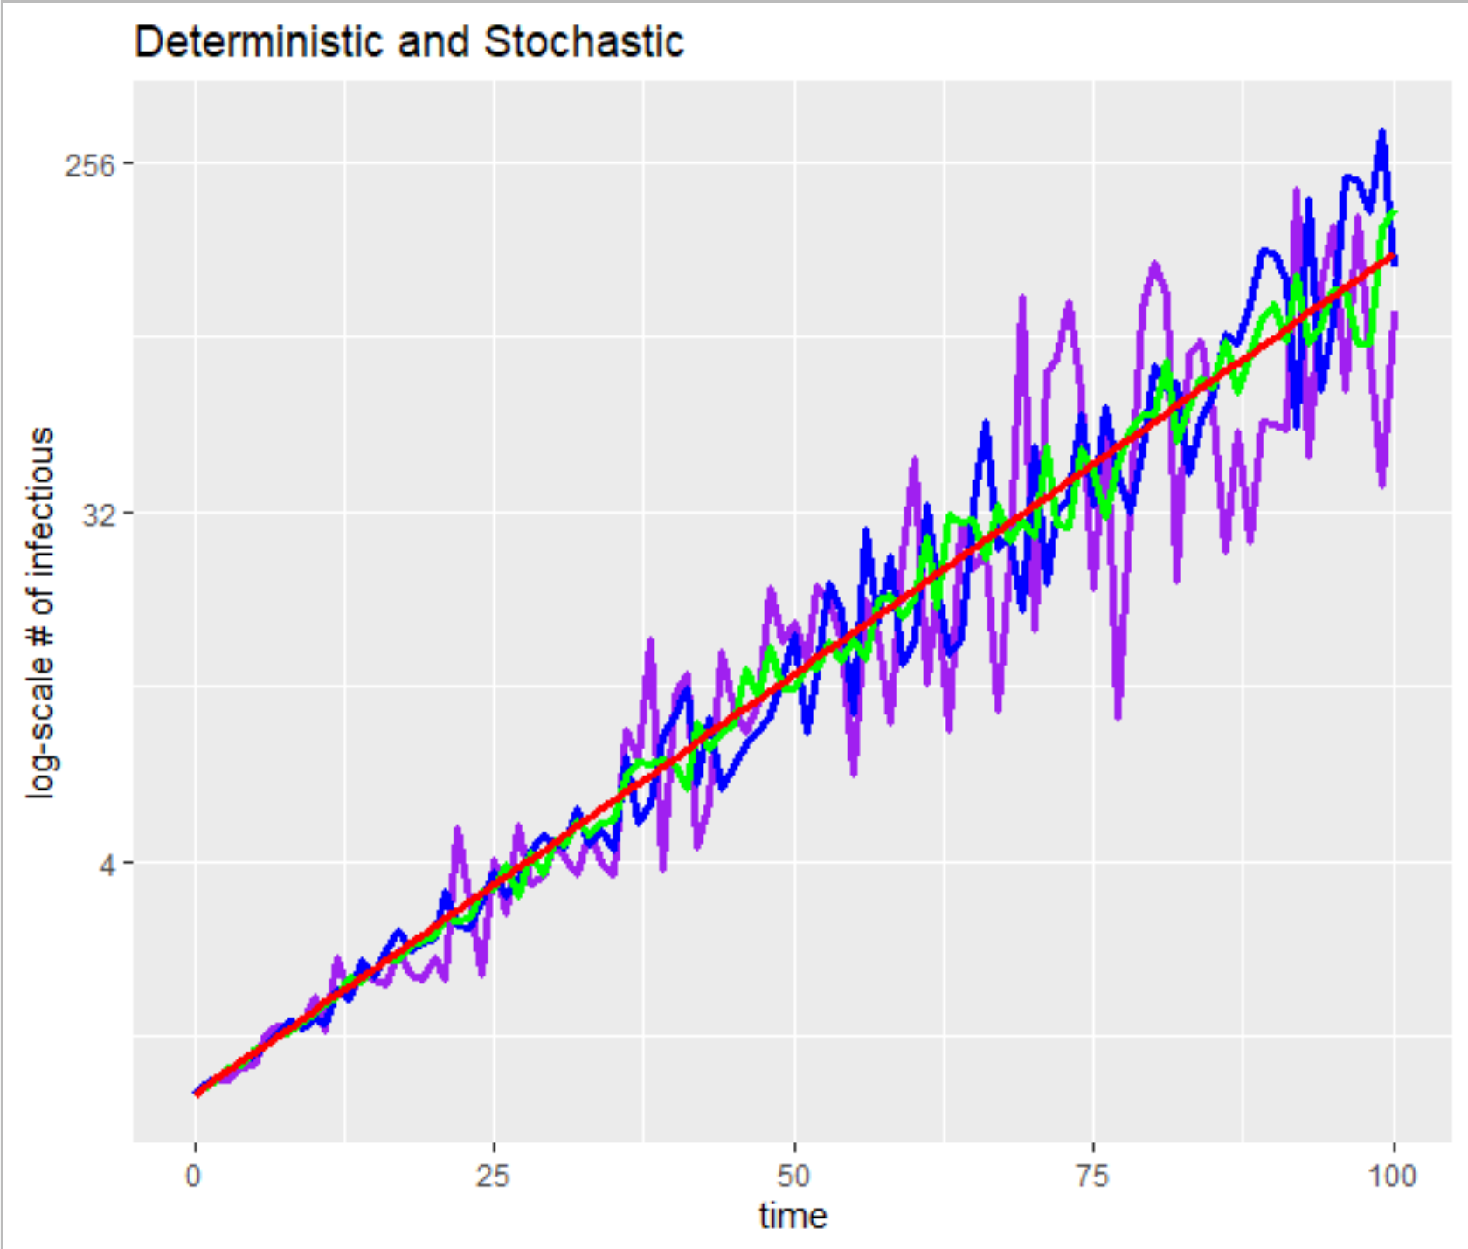

Slide 31
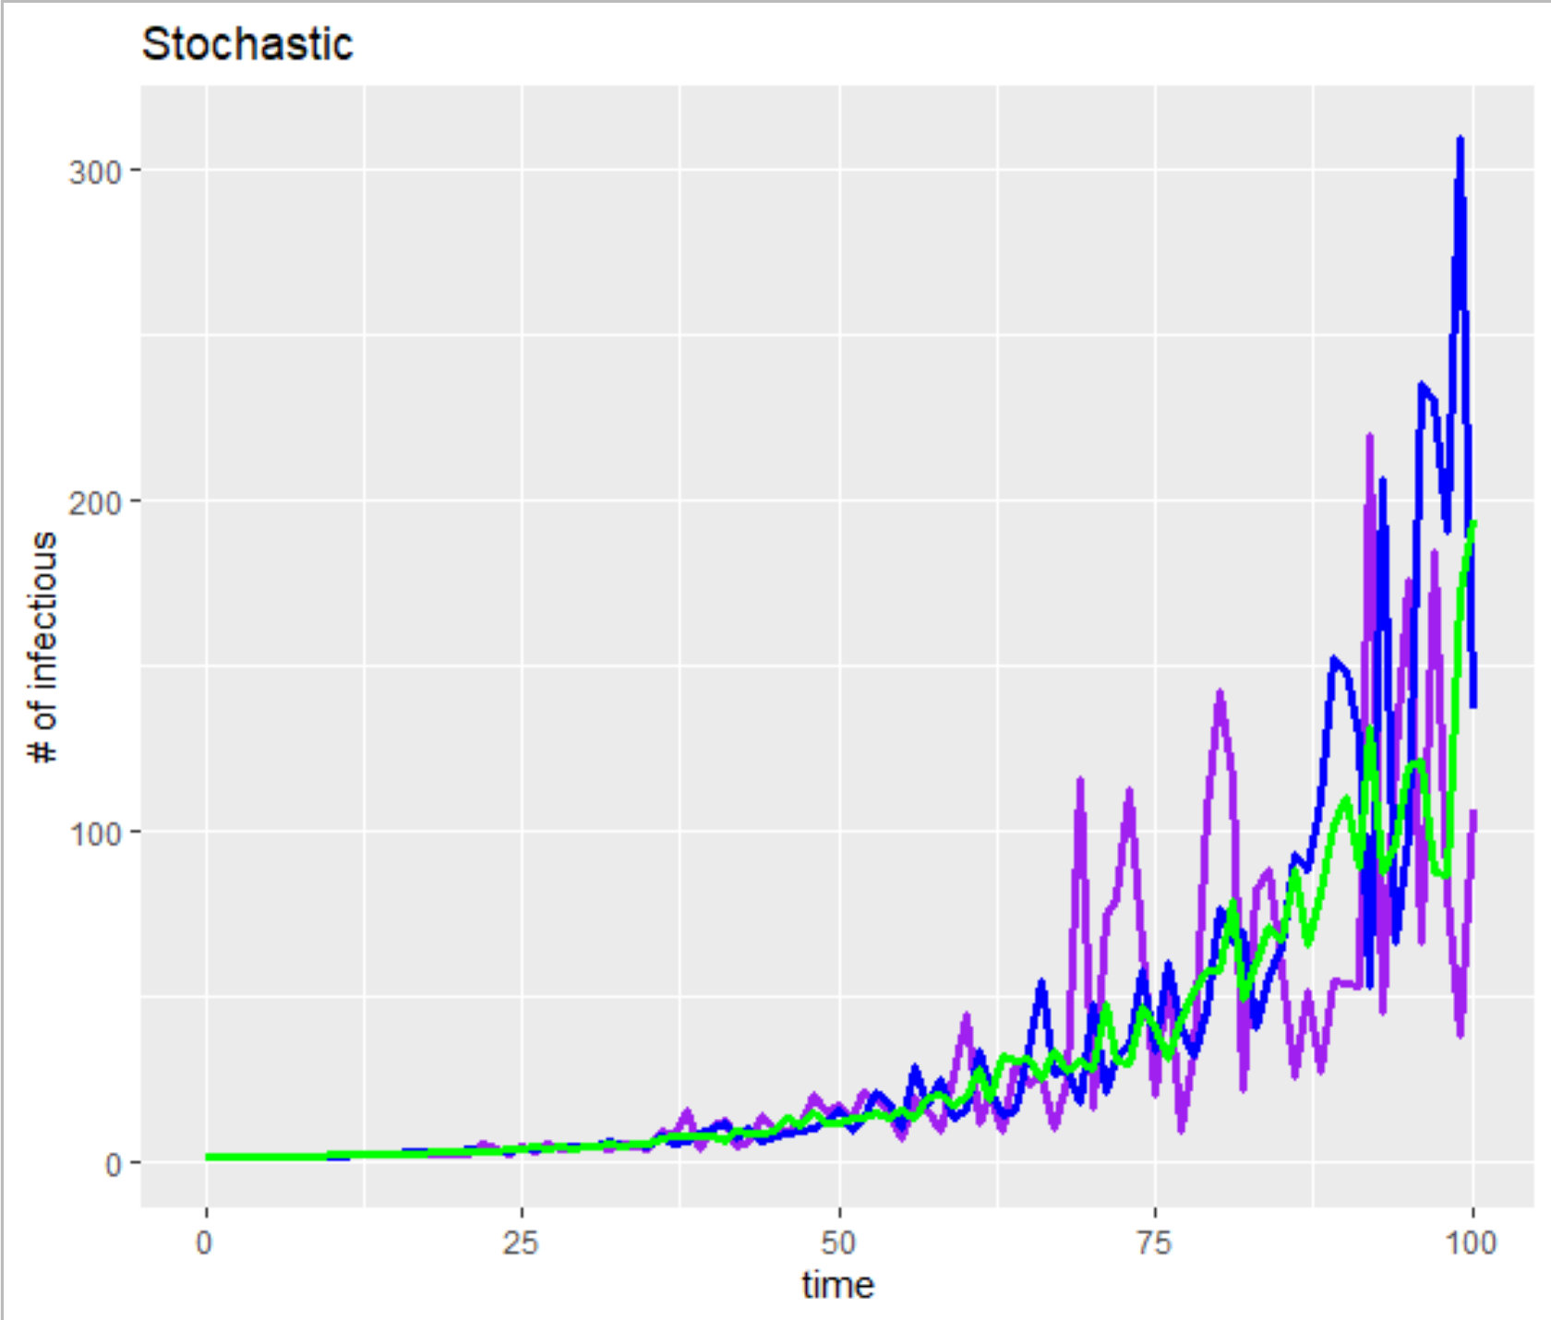
What do you notice about the stochastic model output?
The deterministic simulation had 150 cases at day 100, how do the more noise (blue) and less noise (green) compare?
How about earlier in the series?
What would happen if we ran the simulation again?

Slide 32
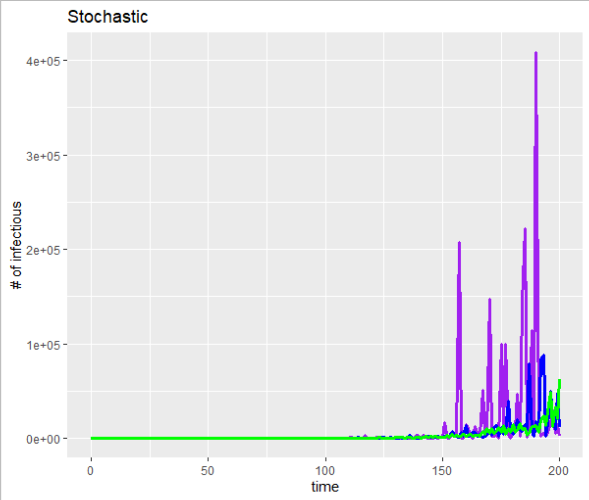
If I extend the time scale out to 200 days, we start to see some interesting patterns. What do you see in terms how the of the amount of noise causes big outbreaks (green=little; blue=a lot; purple=medium),

Slide 33
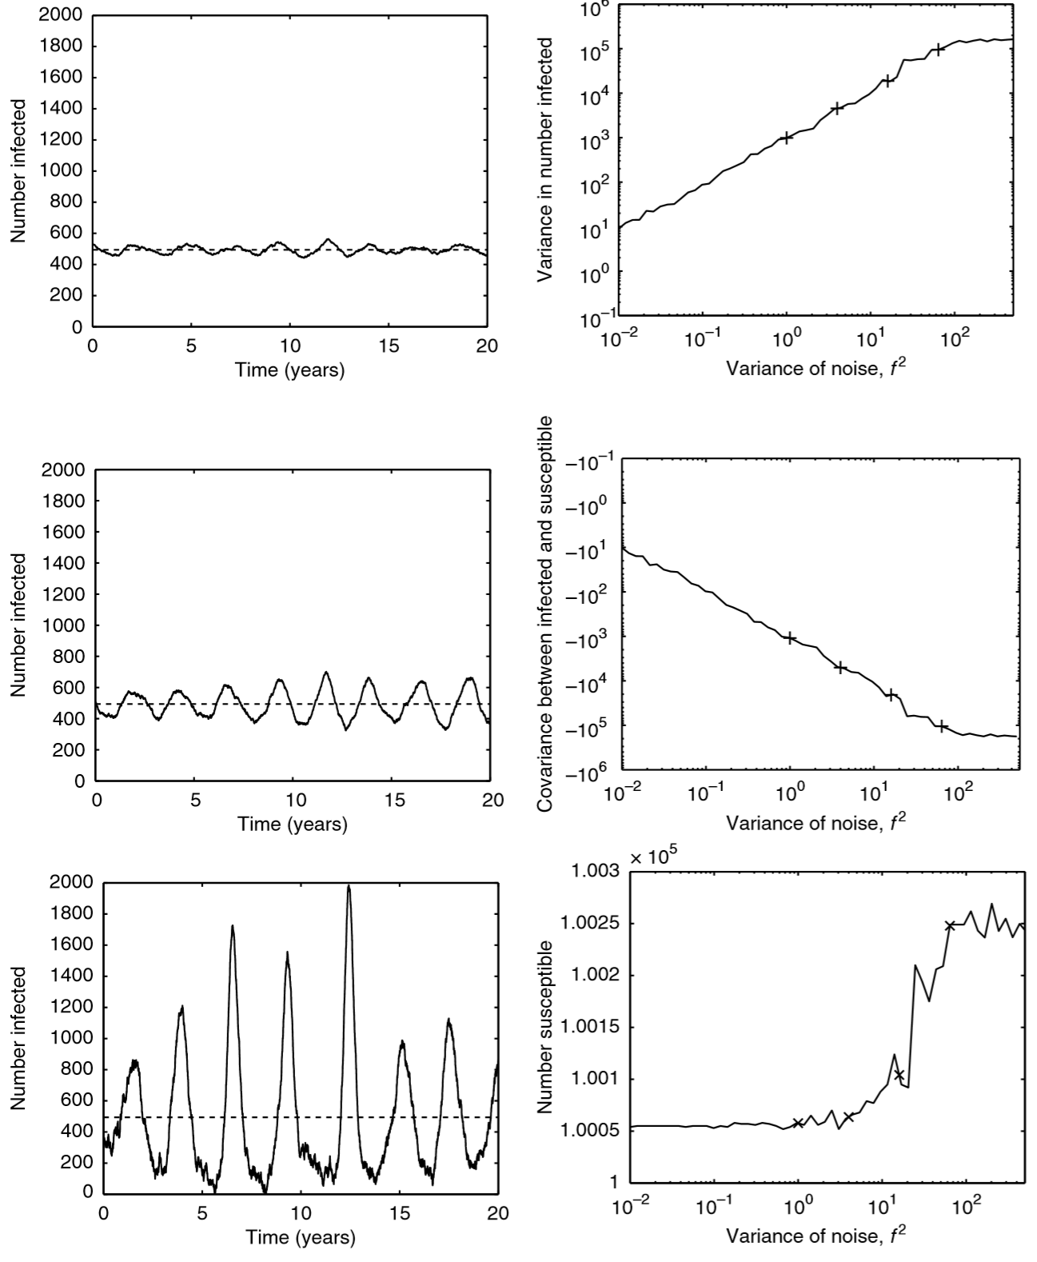
Figure 6.2 (SIR model)
Left panels show fluctuations in # of infected individuals.
Upper has little random noise in Beta
Middle medium noise
Lower has a lot of noise
What do you notice about the differences?

Slide 34
Figure 6.2 (SIR model)
Right panels show measures of variance.
Focus on the lowest panel
When there is more noise (the right of the x-axis), there are more susceptibles on average
The middle panel shows that the covariance between infectious and susceptibles becomes more strongly negative with more noise
What is going on?

Slide 35
What drives the high amplitude epidemics?
S
I
R
βI
γ
b=μ
When β randomly fluctuates below its mean, then
the number of Susceptibles increases, and
the number of Infectious falls, but
With more Susceptibles and
with the potential for β to randomly fluctuate above its mean,
we can get a large and rapid epidemic rise which
depletes the Susceptibles leading to a lower trough…

Slide 36
SIR model with demography: Equilibria and Stability
I Prevalence
(1, 0, 0)
$$S=\frac{1}{R_{0}}$$
S Prevalence

Slide 37
SIR model with demography: Equilibria and Stability
Random fluctuations knock the system off of its damped equilibrium trajectory so that it fluctuates more widely for longer
If the fluctuations are large and frequent enough it may never settle into its equilibrium
I Prevalence
(1, 0, 0)
$$S=\frac{1}{R_{0}}$$
S Prevalence

Slide 38
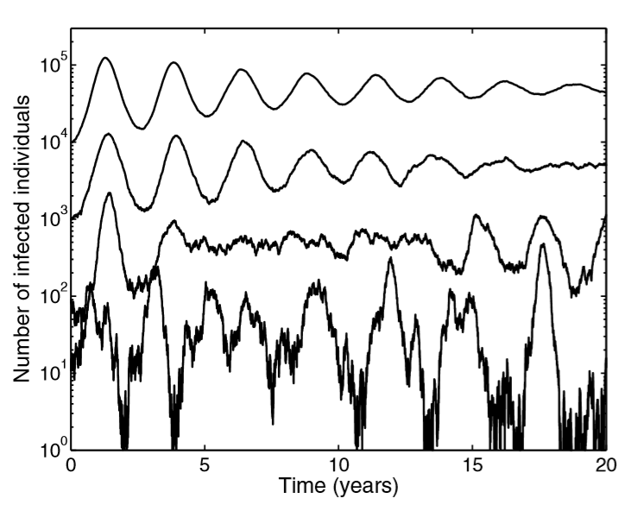
Scaled noise (relative to population size)
When noise is scaled relative to the population size, then small population sizes take longer and have more trouble getting into their stable endemic equilibrium
… Let’s talk more about this

Slide 39
Up until now: Random fluctuations in parameters FOR continuous quantity, continuous time modelS

Slide 40
NOW LET’S CONSIDER DISCRETE QUANTITY DISCRETE TIME MODELS (SIMPLE INDIVIDUAL-BASED MODELS)

Slide 41
States people are in: Susceptible (blue); Infectious (red); Recovered (purple)
S
I
R
βI
γ
b=μ

Slide 42
CASE (SIMULATION) 1: EPIDEMIC TAKE-OFF

Slide 43
t=1
t=2
t=3
t=4

Slide 44
CASE (SIMULATION) 2: EPIDEMIC FADE-OUT

Slide 45
t=1
t=2
t=3
t=4

Slide 46
Simple Individual Based Model
Tracks counts of Susceptibles (X), Infectious (Y), and Recovered (Z)
Each discrete time step,
Chance of each Y infecting each X: Causes count of X to go down and Y to go up by this amount
Chance of each Y recovering: Causes count of Y to go down and Z to go up by this amount
Chance of each Z having immunity wane: Causes count of Z to go down and X to go up by this amount

Slide 47
Simple Individual Based Model
For populations (N=X+Y+Z) of different sizes (10³, 10⁴, 10⁵, 10⁷) we do the following:
Run the model 200 times with each model run over 1000 days
For each model run, plot the counts of Infectious (Y) over time (ordering these by the # of infectious days)
Let’s look at the model code and the plotted results

Slide 48
# PARAMETER INTIATLIZATION
r_transmission <- 0.03
c_contacts <- 5
c_beta <- r_transmission * c_contacts
c_gamma <- 1/10
c_omega <- 1/400
beta_mult <- 1.25
c_end_time <- 1000
n_sims <- 200
pidx <- 1

Slide 49
# THE LOOP TO ANALYZE DIFFERENT POPULATION SIZES
for(pop_size in c(1000, 10000, 100000, 10000000)) {
# INITIALIZATION:
c_Ninit <- pop_size
# START WITH 10 INFECTIOUS (Y)
c_Yinit <- 10
# EVERYONE ELSE IS SUSCEPTIBLE (X)
c_Xinit <- c_Ninit - c_Yinit
# MATRIX TO HOLD SIMULATION OUTPUTS
m_sims <- c()

Slide 50
for(ss in 1:n_sims) {
# INITIALIZE THE MATRIX WE WILL USE TO KEEP
# TRACK OF COUNTS OF X, Y, Z
m_trace <- matrix(0, nrow = c_end_time+1, ncol = 3)
# INIT STARTING POPULATION
for(j in 1:ncol(m_trace)) {
m_trace[1,j] <- ifelse(j==1, c_Xinit,
ifelse(j==2, c_Yinit, 0))
}
# SEE NEXT SLIDE FOR CODE FOREACH MODEL TIME STEP
m_sims <- rbind(m_sims, m_trace[,2])
}

Slide 51
for(i in 2:nrow(m_trace)) {
# CURRENT POPULATION AND INFECTIOUS
N_prev <- sum(m_trace[i-1,])
Y_prev <- m_trace[i-1,2]
# CONVERT FROM RATES TO PERIOD PROBABILITIES
p_transmission <- 1-exp(-1*(beta_mult*c_beta))
p_recovery <- 1-exp(-1*(c_gamma))
p_waning <- 1-exp(-1*(c_omega))
# CHANGES ARE BINOMIAL DISTRIBUTED
deltaX <- rbinom(1, m_trace[i-1,1],
p_transmission*Y_prev/N_prev)
deltaY <- rbinom(1, m_trace[i-1,2],p_recovery)
deltaZ <- rbinom(1, m_trace[i-1,3],p_waning)
UPDATE COUNTS FROM TIME i-1 TO TIME i
m_trace[i, 1] <- m_trace[i-1, 1] - deltaX + deltaZ
m_trace[i, 2] <- m_trace[i-1, 2] + deltaX - deltaY
m_trace[i, 3] <- m_trace[i-1, 3] + deltaY - deltaZ
}

Slide 52
Orientation: We plot the prevalent infectious cases for each simulation run, coloring it by the magnitude; We sort these plots by the area under the curve (# of infectious days)
# Infectious
Time

Slide 53
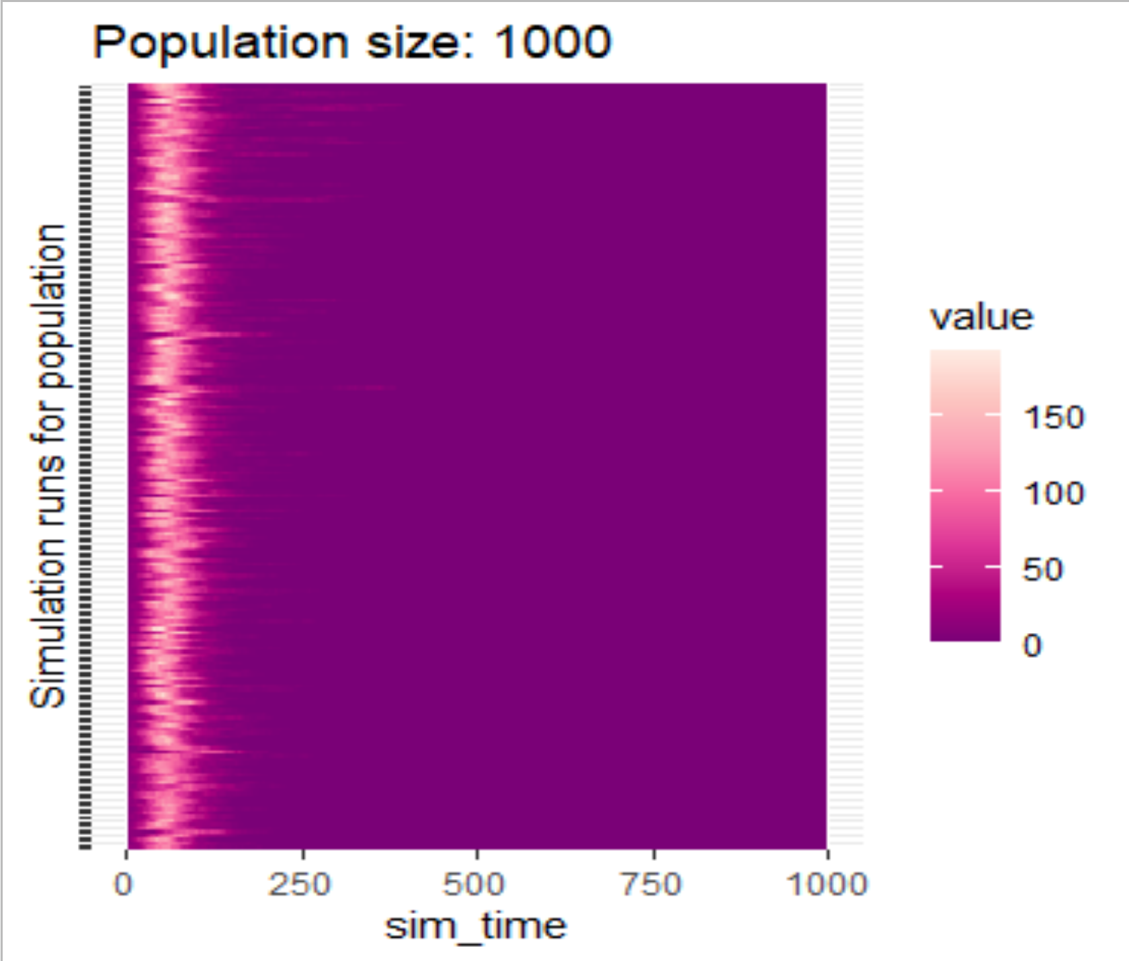
No one is infectious after day 500!
Some runs have sporadic smaller non-sustainable secondary outbreaks

Slide 54
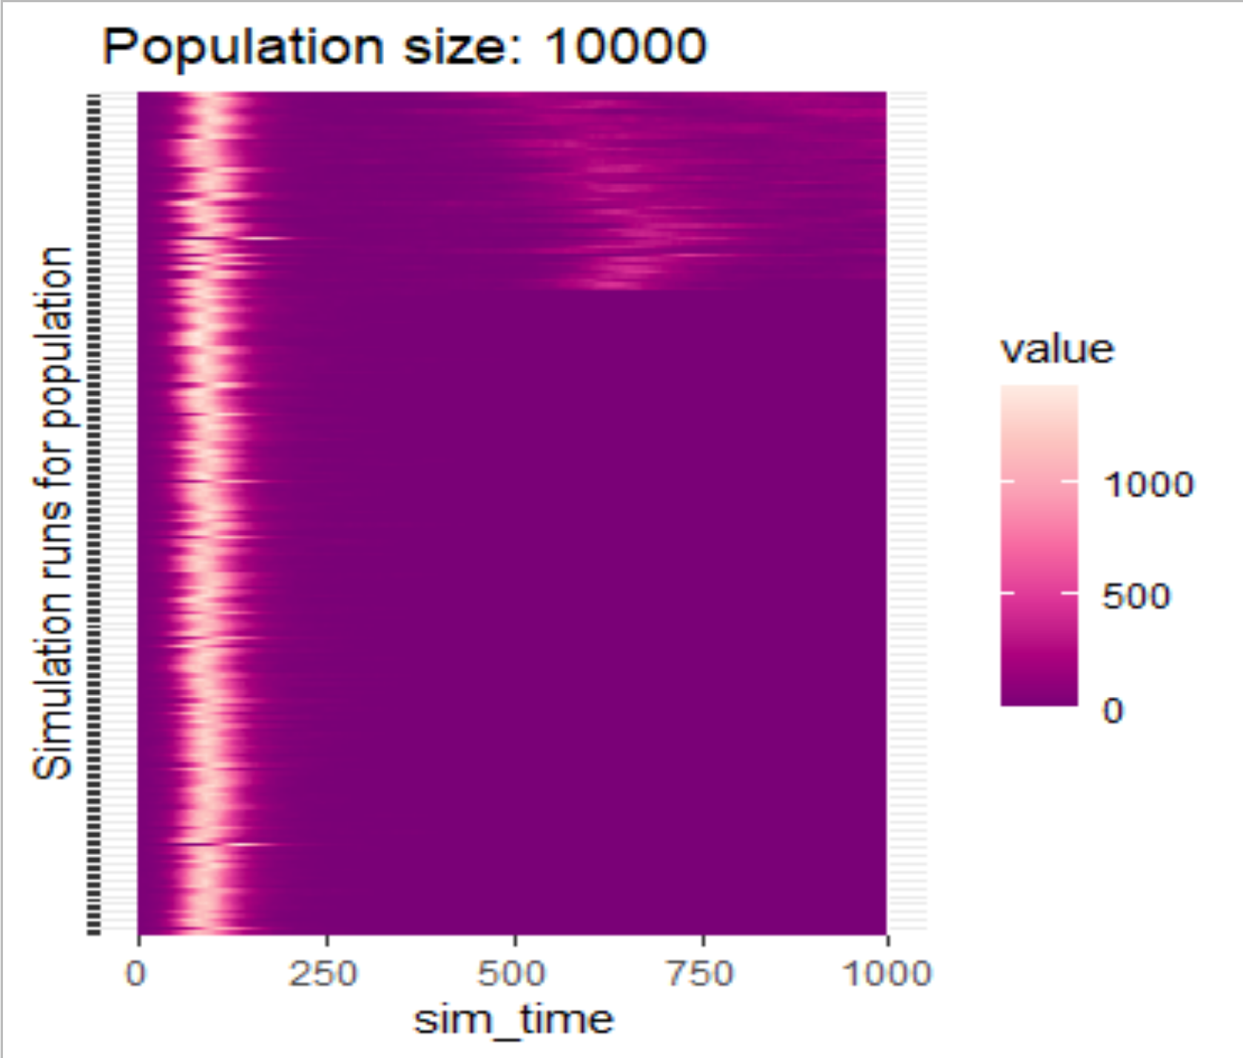
With larger population size a portion of model runs have sustained epidemics out to 1000 days

Slide 55
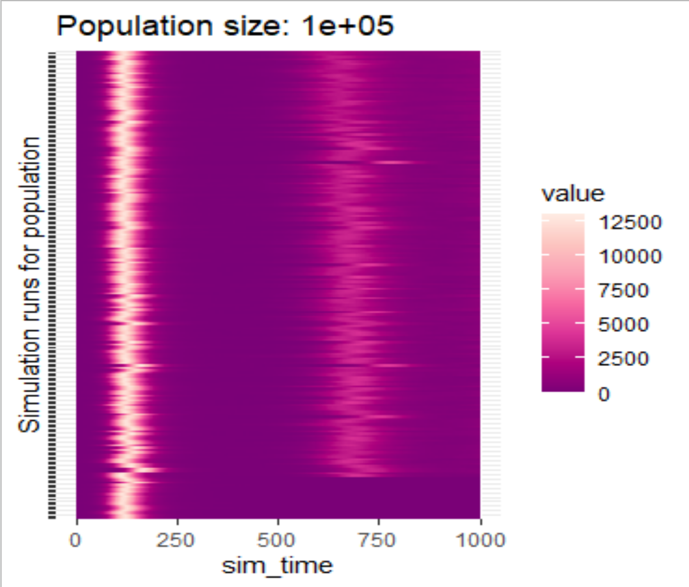
With even larger population size a larger portion of model runs have sustained epidemics out to 1000 days; it is a secondary epidemic peaks!

Slide 56
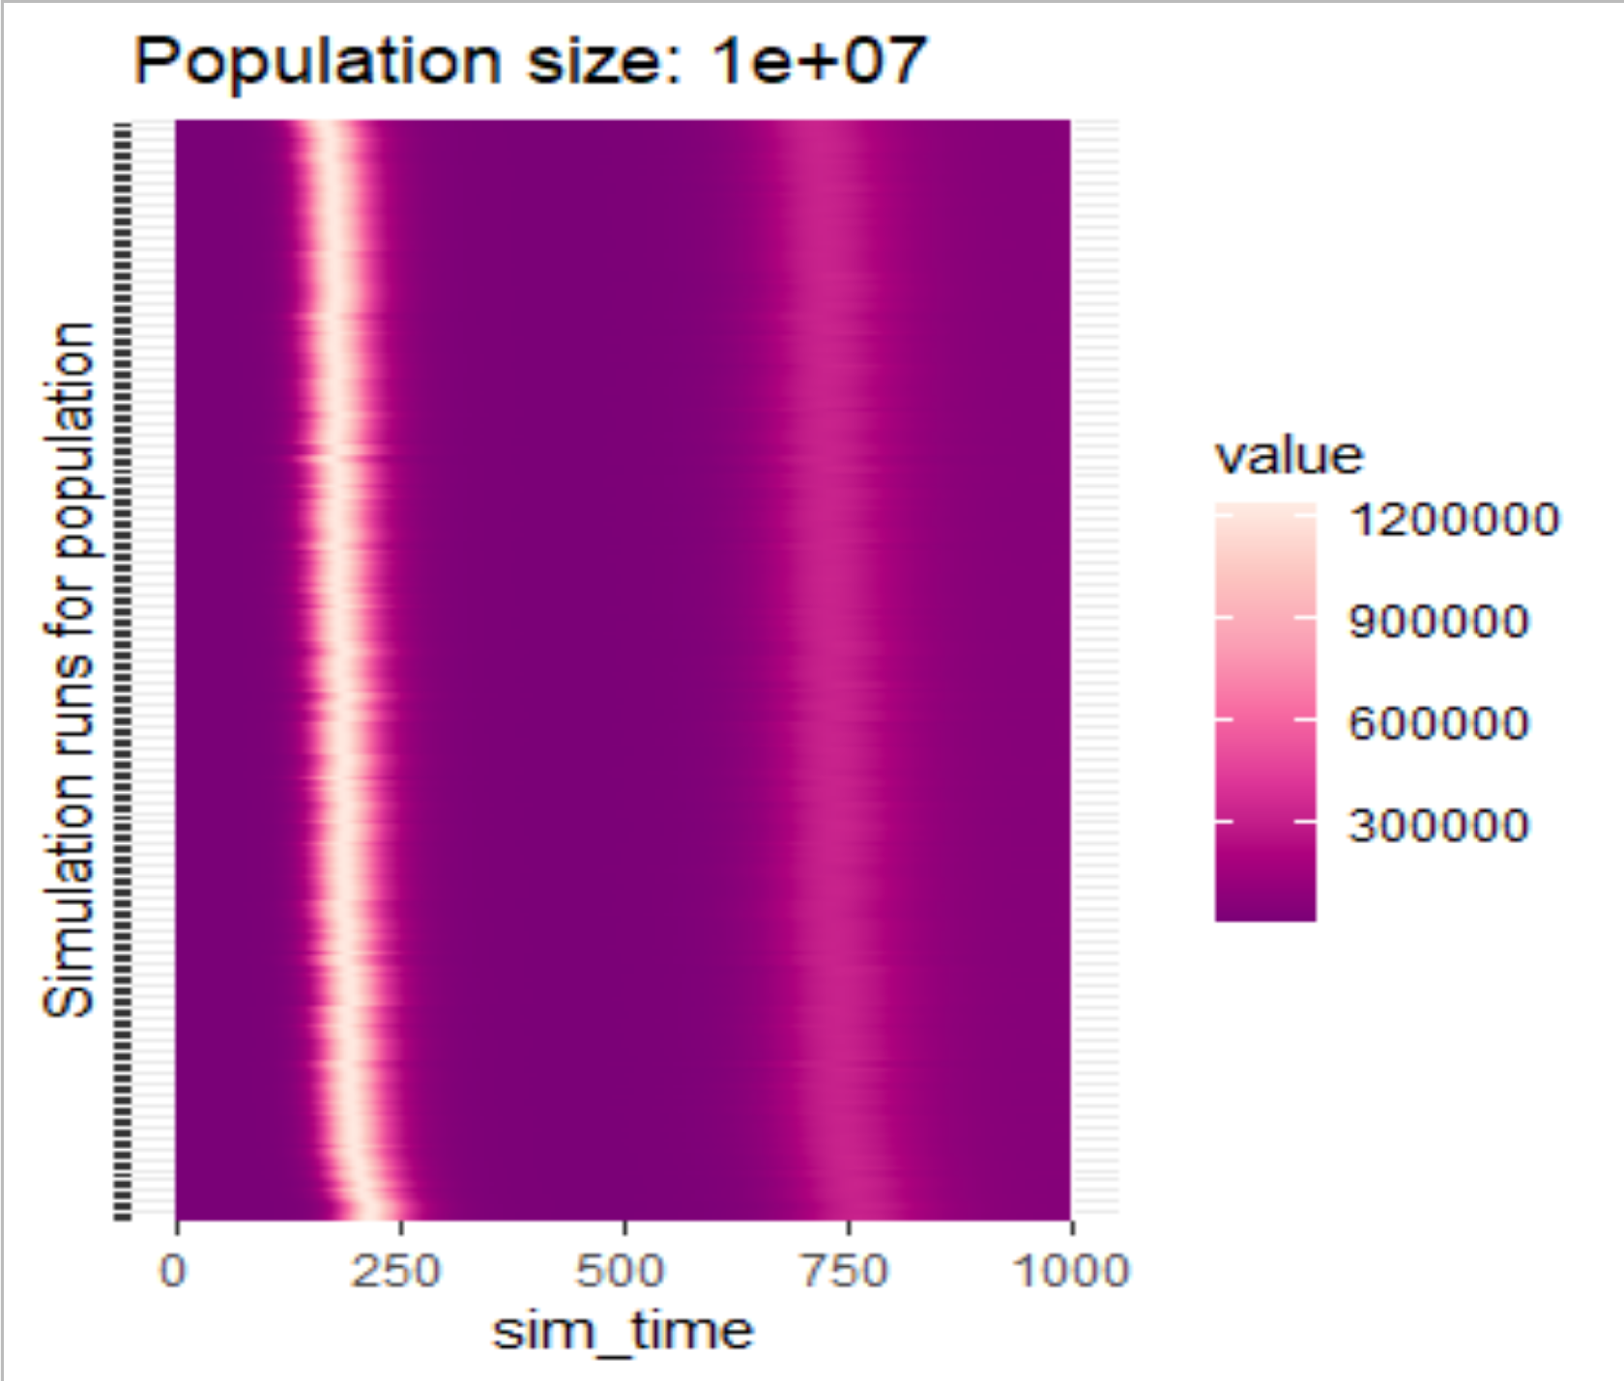
With very large population sizes, almost all runs behave like a continuous time, continuous count model

Slide 57
Stochastic Fade-out/Extinction
In continuous/deterministic models, when the infection prevalence is low, the rate of growth of infectious individual is large
This is true for the stochastic individual model, but there is a chance that the # of infectious will go to 0 and then there will be no further growth

Slide 58
Stochastic Fade-out/Extinction
# Infectious
Time

Slide 59
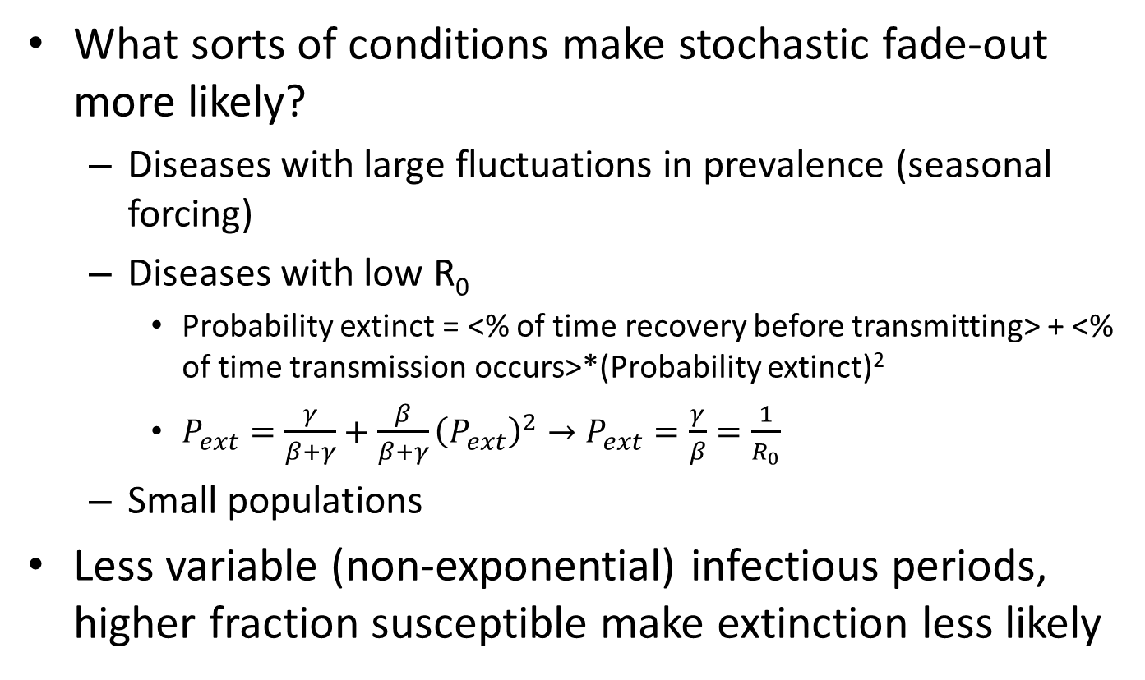
Stochastic Fade-out/Extinction
What sorts of conditions make stochastic fade-out more likely?
Diseases with large fluctuations in prevalence (seasonal forcing)
Diseases with low R₀
Probability extinct = <% of time recovery before transmitting> + <% of time transmission occurs>*(Probability extinct)²
$P_{ext}=\frac{γ}{β+γ}+\frac{β}{β+γ}{\left(P_{ext}\right)}^{2}→P_{ext}=\frac{γ}{β}=\frac{1}{R_{0}}$
Small populations
Less variable (non-exponential) infectious periods, higher fraction susceptible make extinction less likely

Slide 60
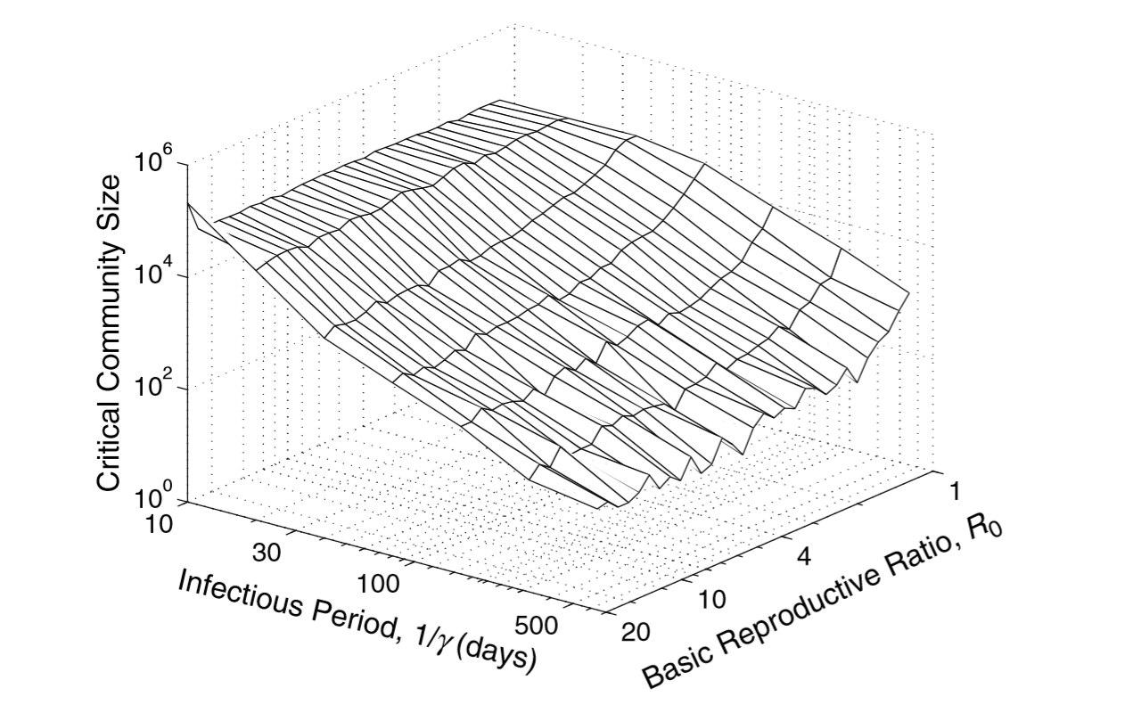
Critical Community Size
The Critical Community Size (CCS) is deﬁned as the smallest population size that does not suffer disease extinction.

Slide 61
Importance of importations
Importation: Infectious individuals arrive from outside OR susceptible person temporarily leaves, while away becomes infected, and returns
S
I
R
βI
γ
b=μ

Slide 62
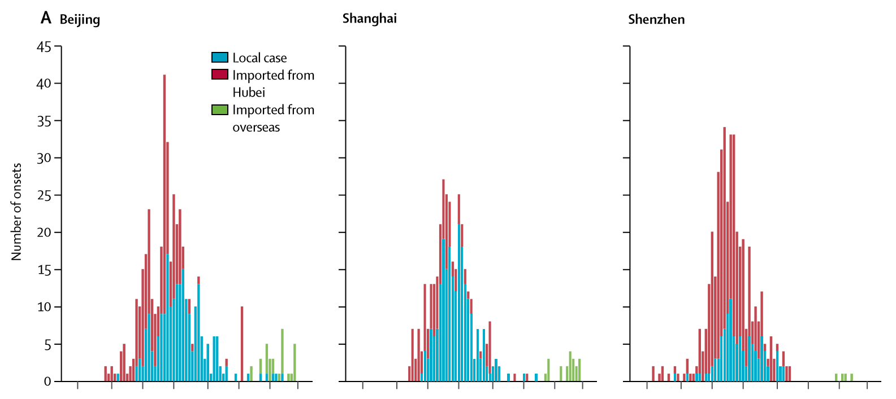
COVID19 Importation Stories

Slide 63
Important Announcements

